Slide 1
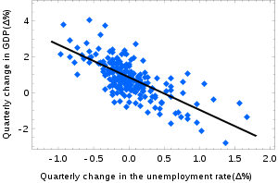
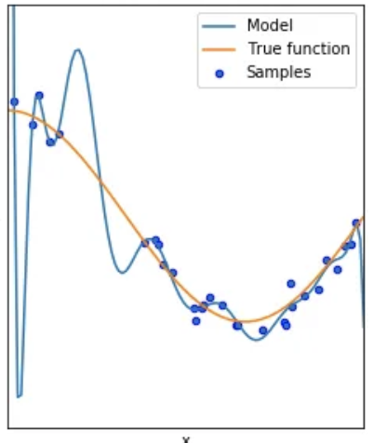
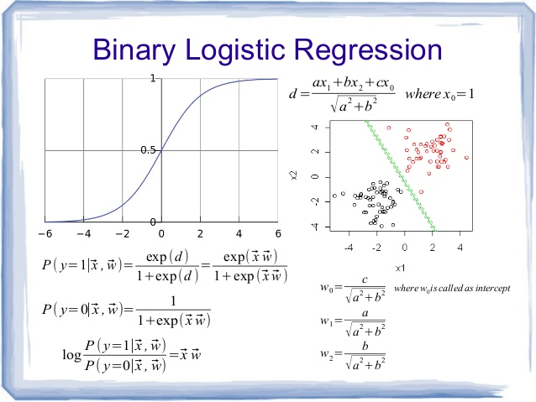
Lecture 30: Linear Regression, Logistic Regression and Regularization
Objectives:
The Linear Regression Model Least Squares Solution The Logistic Regression Model Multiclass Logistic Regression
Resources:
Textbook (Sections 3.1 – 3.A) RealPython: Linear Regression in Python RealPython: Logistic Regression in Python TowardsDataScience: Regularization TowardsDataScience: Stochastic Gradient Descent

Slide 2
Summary
Linear regression using simple metrics like mean square error often results in closed-form solutions for optimal parameters.
Logistic regression is used to convert binary data, or categorical data, to a form that enables application of regression techniques.
The parameter optimization problem for more complex models often involves a series of nonlinear equations that do not have closed-form solution. Hence, we must use iterative algorithms based on gradient descent principles.
It is difficult to solve these complex optimization problems due to the the vanishing gradient problem (derivatives go to zero at a local minimum).
Regularization allows us to achieve near optimal solutions by converting these complex cost functions into a convex function.

Slide 3
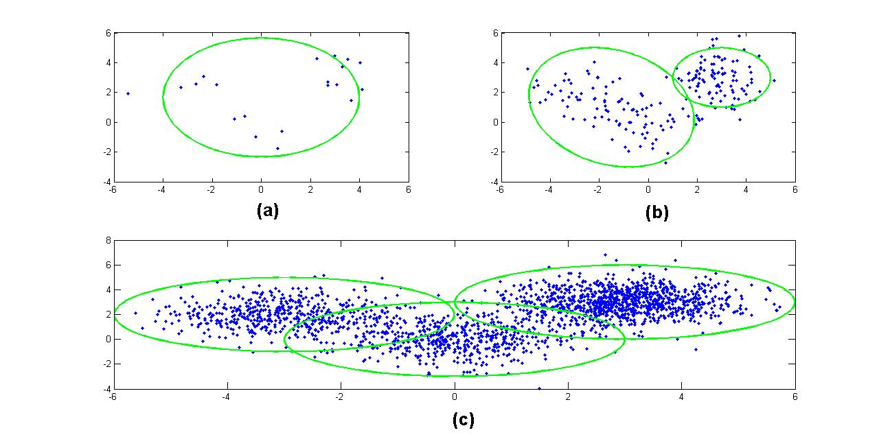
Lecture 30: Regularization
Objectives: Iterative Solutions Convex Optimization Regularizers P-Norms
Resources: Quora: Regularization BB: Regularization Teh: Bayesian Nonparametric Models Orbanz: Nonparametric Models

Slide 4
Regularization
David Kauchak CS 451 – Fall 2013

Slide 5
Model-based machine learning
pick a model
pick a criteria to optimize (aka objective function)
develop a learning algorithm
Find w and b that minimize the 0/1 loss

Slide 6
Model-based machine learning
pick a model
pick a criteria to optimize (aka objective function)
develop a learning algorithm
use a convex surrogate loss function
Find w and b that minimize the surrogate loss

Slide 7


Finding the minimum
You’re blindfolded, but you can see out of the bottom of the blindfold to the ground right by your feet. I drop you off somewhere and tell you that you’re in a convex shaped valley and escape is at the bottom/minimum. How do you get out?

Slide 8
Gradient descent
pick a starting point (w)
repeat until loss doesn’t decrease in all dimensions:
pick a dimension
move a small amount in that dimension towards decreasing loss (using the derivative)

Slide 9
Some maths

Slide 10
Gradient descent
pick a starting point (w)
repeat until loss doesn’t decrease in all dimensions:
pick a dimension
move a small amount in that dimension towards decreasing loss (using the derivative)
What is this doing?

Slide 11
Perceptron learning algorithm!
repeat until convergence (or for some # of iterations):
for each training example (f₁, f₂, …, f_{m}, label):
if prediction * label ≤ 0: // they don’t agree
for each w_{j}:
w_{j} = w_{j} + f_{j}*label
b = b + label
or
where

Slide 12
The constant
learning rate
label
prediction
When is this large/small?

Slide 13
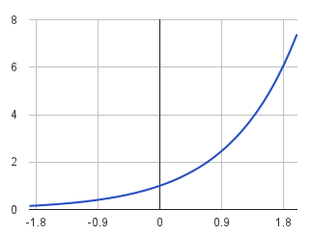
The constant
label
prediction
If they’re the same sign, as the predicted gets larger there update gets smaller
If they’re different, the more different they are, the bigger the update

Slide 14
One concern
loss
What is this calculated on?
Is this what we want to optimize?
w

Slide 15
Perceptron learning algorithm!
repeat until convergence (or for some # of iterations):
for each training example (f₁, f₂, …, f_{m}, label):
if prediction * label ≤ 0: // they don’t agree
for each w_{j}:
w_{j} = w_{j} + f_{j}*label
b = b + label
Note: for gradient descent, we always update
or
where

Slide 16
One concern
loss
We’re calculating this on the training set
We still need to be careful about overfitting!
The min w,b on the training set is generally NOT the min for the test set
w
How did we deal with this for the perceptron algorithm?

Slide 17
Overfitting revisited: regularization
A regularizer is an additional criteria to the loss function to make sure that we don’t overfit
It’s called a regularizer since it tries to keep the parameters more normal/regular
It is a bias on the model forces the learning to prefer certain types of weights over others

Slide 18
Regularizers
Should we allow all possible weights?
Any preferences?
What makes for a “simpler” model for a linear model?

Slide 19
Regularizers
Generally, we don’t want huge weights
If weights are large, a small change in a feature can result in a large change in the prediction
Also gives too much weight to any one feature
Might also prefer weights of 0 for features that aren’t useful
How do we encourage small weights? or penalize large weights?

Slide 20
Regularizers
How do we encourage small weights? or penalize large weights?

Slide 21
Common regularizers
sum of the weights
sum of the squared weights
What’s the difference between these?

Slide 22
Common regularizers
sum of the weights
sum of the squared weights
Squared weights penalizes large values more
Sum of weights will penalize small values more

Slide 23
p-norm
sum of the weights (1-norm)
sum of the squared weights (2-norm)
p-norm
Smaller values of p (p < 2) encourage sparser vectors
Larger values of p discourage large weights more

Slide 24
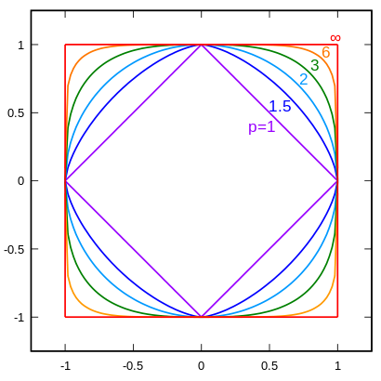
p-norms visualized
lines indicate penalty = 1
w₁
w₂
p | w₂
1 | 0.5
1.5 | 0.75
2 | 0.87
3 | 0.95
∞ | 1
For example, if w₁ = 0.5

Slide 25
p-norms visualized
all p-norms penalize larger weights
p < 2 tends to create sparse (i.e. lots of 0 weights)
p > 2 tends to like similar weights
Notes:
- The 1 norm penalizes non-zero weights, e.g

Slide 26

Model-based machine learning
pick a model
pick a criteria to optimize (aka objective function)
develop a learning algorithm
Find w and b that minimize

Slide 27
Minimizing with a regularizer
We know how to solve convex minimization problems using gradient descent:
If we can ensure that the loss + regularizer is convex then we could still use gradient descent:
make convex

Slide 28
Convexity revisited
One definition: The line segment between any two points on the function is above the function
Mathematically, f is convex if for all x₁, x₂:
the value of the function at some point between x₁ and x₂
the value at some point on the line segment between x₁ and x₂
Notes:
Put another way, the right hand side says, take the value of the function at x1, take the value of the function at x2 and then “linearly” average them based on t. This represents a line segment between f(x1) and f(x2)

Slide 29
Adding convex functions
Claim: If f and g are convex functions then so is the function z=f+g
Prove:
Mathematically, f is convex if for all x₁, x₂:

Slide 30
Adding convex functions
By definition of the sum of two functions:
Then, given that:
We know:
So:

Slide 31
Minimizing with a regularizer
We know how to solve convex minimization problems using gradient descent:
If we can ensure that the loss + regularizer is convex then we could still use gradient descent:
convex as long as both loss and regularizer are convex

Slide 32
p-norms are convex
p-norms are convex for p >= 1

Slide 33
Model-based machine learning
pick a model
pick a criteria to optimize (aka objective function)
develop a learning algorithm
Find w and b that minimize

Slide 34
Our optimization criterion
Loss function: penalizes examples where the prediction is different than the label
Regularizer: penalizes large weights
Key: this function is convex allowing us to use gradient descent

Slide 35
Gradient descent
pick a starting point (w)
repeat until loss doesn’t decrease in all dimensions:
pick a dimension
move a small amount in that dimension towards decreasing loss (using the derivative)

Slide 36
Some more math
…
(some math happens)

Slide 37
Gradient descent
pick a starting point (w)
repeat until loss doesn’t decrease in all dimensions:
pick a dimension
move a small amount in that dimension towards decreasing loss (using the derivative)

Slide 38
The update
learning rate
direction to update
regularization
constant: how far from wrong
What effect does the regularizer have?

Slide 39
The update
learning rate
direction to update
regularization
constant: how far from wrong
If w_{j} is positive, reduces w_{j}
If w_{j} is negative, increases w_{j}
moves w_{j} towards 0

Slide 40
L1 regularization

Slide 41
L1 regularization
learning rate
direction to update
regularization
constant: how far from wrong
What effect does the regularizer have?

Slide 42
L1 regularization
learning rate
direction to update
regularization
constant: how far from wrong
If w_{j} is positive, reduces by a constant
If w_{j} is negative, increases by a constant
moves w_{j} towards 0
regardless of magnitude

Slide 43
Regularization with p-norms
L1:
L2:
Lp:
How do higher order norms affect the weights?
Notes:
if they’re magnitude > 1, reduce them drastically
if they’re magnitude < 1, much slower reductions for higher p

Slide 44
Regularizers summarized
L1 is popular because it tends to result in sparse solutions (i.e. lots of zero weights)
However, it is not differentiable, so it only works for gradient descent solvers
L2 is also popular because for some loss functions, it can be solved directly (no gradient descent required, though often iterative solvers still)
Lp is less popular since they don’t tend to shrink the weights enough

Slide 45
The other loss functions
Without regularization, the generic update is:
where
exponential
hinge loss
squared error

Slide 46
Many tools support these different combinations
Look at scikit learning package:
http://scikit-learn.org/stable/modules/sgd.html

Slide 47
Common names
(Ordinary) Least squares: squared loss
Ridge regression: squared loss with L2 regularization
Lasso regression: squared loss with L1 regularization
Elastic regression: squared loss with L1 AND L2 regularization
Logistic regression: logistic loss

